Slide 1
Are You an Accident of Nature?
Part 6
No information by chance
in any universe

Slide 2
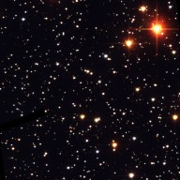
Visible Universe
Boundary of light that can reach earth
Expands
No light or alien can reach earth from outside the visible universe.

Slide 3
Best Case Analysis
Could time, chance, and the visible universe create a single protein?

Slide 4
Best Case Analysis - Universe
Assume:
Universe is 100 billion years old
Every place in universe is perfect for life
There is no empty space in universe. It is all filled with hydrogen atoms packed so tightly they have the density of lead.
Every atom in the universe is a computer guessing DNA sequences for proteins at the rate of 1 billion times per second.

Slide 5
Life on from Outer Space?
How many combinations if every atom in the visible universe was calculating at 1 billion combinations per second for 100 billion years?
177
Provided: 2.2 x 10
312
Required: 1.0 x 10
(For 1 typical protein)

Slide 6
Impossible that chance created the information for proteins.

Slide 7
Not in Any Universe
Law of Entropy prevents organization
Water prevents amino acids from forming the long chains needed for proteins.
Oxygen attacks DNA and RNA
just like it causes iron to rust
Right handed Amino Acids ruin protein
Information is not created by chance
Notes:
Information would be broken down by the Law of Entropy long before it could form the information for even a single protein. No matter what form the information is recorded in, paper, DVD, stone, or DNA, in nature, without intelligent intervention, the rate of the decay far exceeds the rate of producing. If nature could somehow produce half a protein’s info on Mars and half a protein’s info on Jupiter, the half proteins would broken down long before they found a matching half.
Below From http://chemwiki.ucdavis.edu/Physical_Chemistry/Equilibria/Solubilty/Hydrolysis
Hydrolysis is a reaction involving the breaking of a bond in a molecule using water. The reaction mainly occurs between an ion and water molecules and often changes the pH of a solution. In chemistry, there are three main types of hydrolysis: salt hydrolysis, acid hydrolysis, and base hydrolysis.
dictionary.reference.com/browse/hydrolysis
chemical decomposition in which a compound is split into other compounds by reacting with water

Slide 8
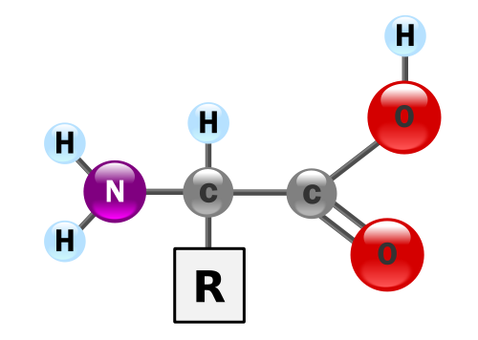
The Water Problem
R1
R2
Structure drawing by Yassine Mrabet
Animation by John Derewianka and Mike Cupit

Slide 9
The Water Problem
Bonded Amino Acids
R1
R2
Structure drawing by Yassine Mrabet
Animation by John Derewianka and Mike Cupit

Slide 10
Protein Secondary Structure
In nature left and right handed amino acids occur in equal numbers
Nearly all of life is made of only left handed amino acids
Stable structure depends on hydrogen bonds between adjacent amino acids
Notes:
We know for certain: Than Chance + Natural Selection could not create a single typical human protein. We will explain that in one of the following videos.

Slide 11
Chance of getting all Left-Handed
For medium protein of 300 AA
1 chance in about 10⁹⁰
Only 10⁸⁰ atoms in observable universe
Notes:
We know for certain: Than Chance + Natural Selection could not create a single typical human protein. We will explain that in one of the following videos.

Slide 12
Impossible
Not remotely possible a protein of all left-handed amino acids would form in nature.
Notes:
We know for certain: Than Chance + Natural Selection could not create a single typical human protein. We will explain that in one of the following videos.

Slide 13
Alien Life Forms
Nature cannot create physical
Angels?
Demons?

Slide 14
Give your own presentations.
Free downloads of PowerPoints used in these videos at:
Educate7.com

Slide 15
Next
Are You an Accident of Nature?
Part 7
No information by chance -
Common sense

